Slide 1
Major Project Presentation
Chhatrapati Shivaji Institute of Technology, Durg
Computer Science & Engineering Department
Semester – 8th
Section - B
Programmer’s Keyboard
Developed by
Annim Banerjee ( 101 )
3032209112
Rishabh Sharma ( 106 )
3032209121
Srijan Tiwari ( 87 )
3032209092
Under the Supervision of
Mr. Saket Soni.
Asst. Professor
CSE Department.

Slide 2
Contents
Abstract
Overview
Challenges
Methodology
Solution
Result
Scope
Bibliography

Slide 3
Abstract

Slide 4
Abstract
Designing and building of a keyboard with those feature which helps in speeding up the programmer or say to coder to do coding on the respective IDE editor window.

Slide 5
Overview

Slide 6
Overview
This project is partly based on embedded systems and rest of the part is software based.
Special key sets are provided which are dedicated to do specific task.
This project is been developed keeping the programmers as our audience.
This project has been developed in two languages, C++ and C#.

Slide 7
Overview
This project is not been developed as per IEEE, FCC( Federal Communication Commission ) Electronics specification.
This keyboard having an USB interface to connect with your system.
A software will been developed for rendering this keyboard from your system.

Slide 8
Challenges

Slide 9
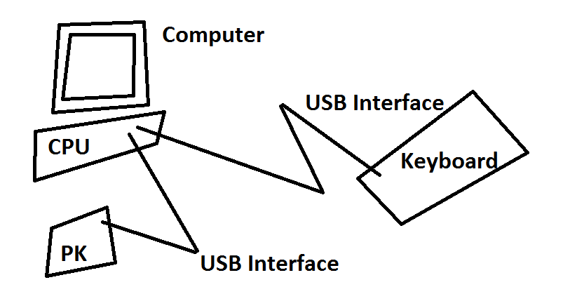
Challenges
To provide such an interface which is from current technology. One of them is USB(Universal Serial Bus).
The key arrangement.
The monitoring control unit.
How we can implement the same without any kind of special control system, instead, just using simple logic gates and registers etc.
Communication from our device to computer.

Slide 10
Methodology

Slide 11
Methodology
Hardware Modules
Keyboard Module
Controller Module
Software Modules
Software in C++ using WinAPI.
Software In C# .NET.

Slide 12
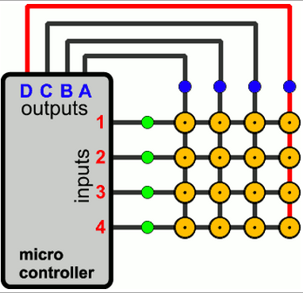
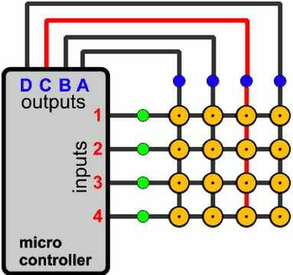
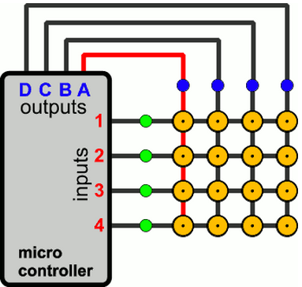
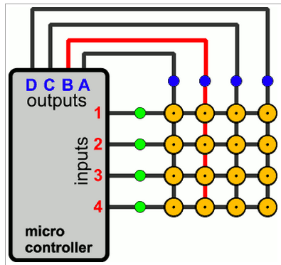
Methodology
Keyboard Module along with controller connection…

Slide 13
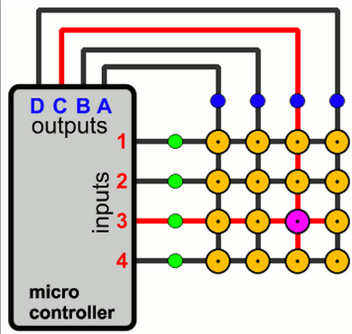
Methodology
Keyboard Module along with controller connection…

Slide 14
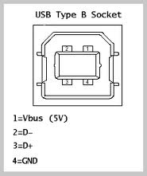
Methodology
Controller Module along with serial communication connection
MCU
USB to UART Bridge
RXD
TXD

Slide 15
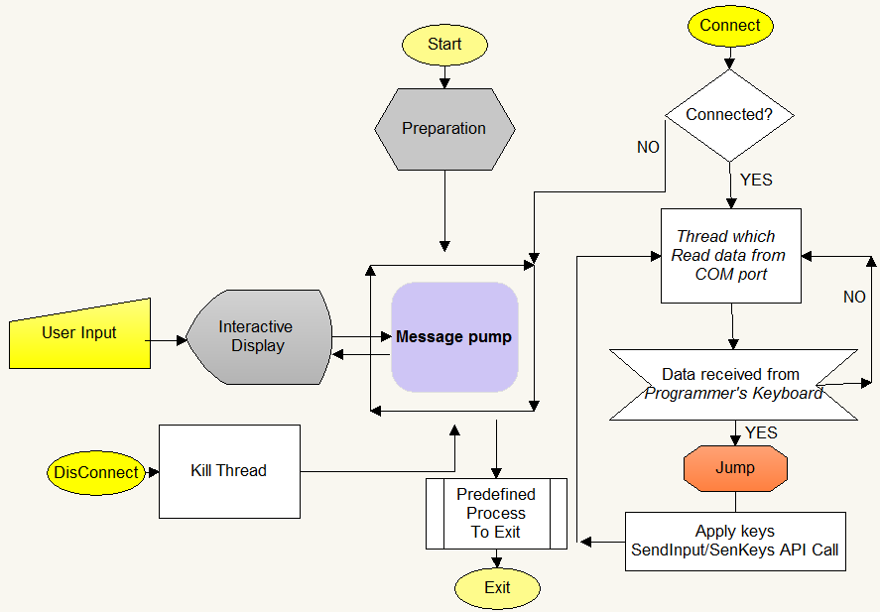
Methodology
Software front

Slide 16
Solutions

Slide 17
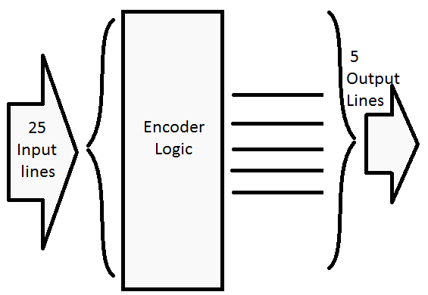
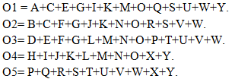
Solution
To make the same without MCU and USB to UART bridge…
To derive an encoder logic.

Slide 18
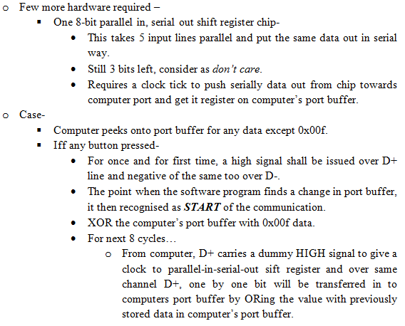
Solution
To communication of MCU with computer

Slide 19
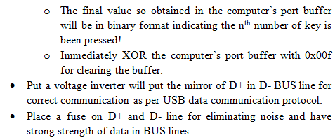
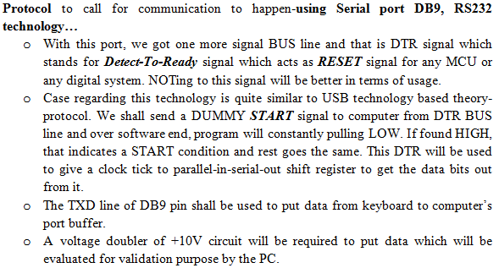
Solution
To communication of MCU with computer

Slide 20
Results

Slide 21
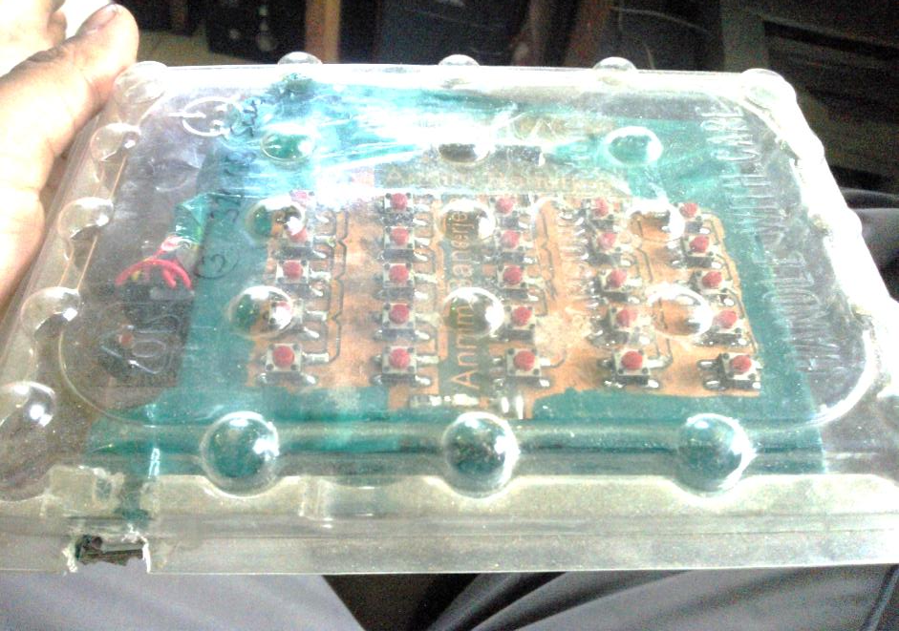
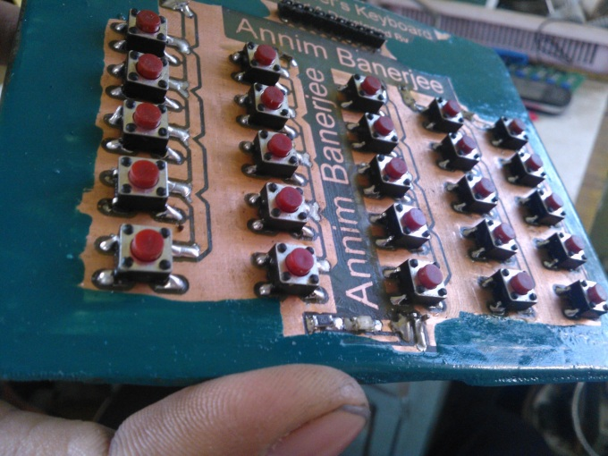
Results

Slide 22
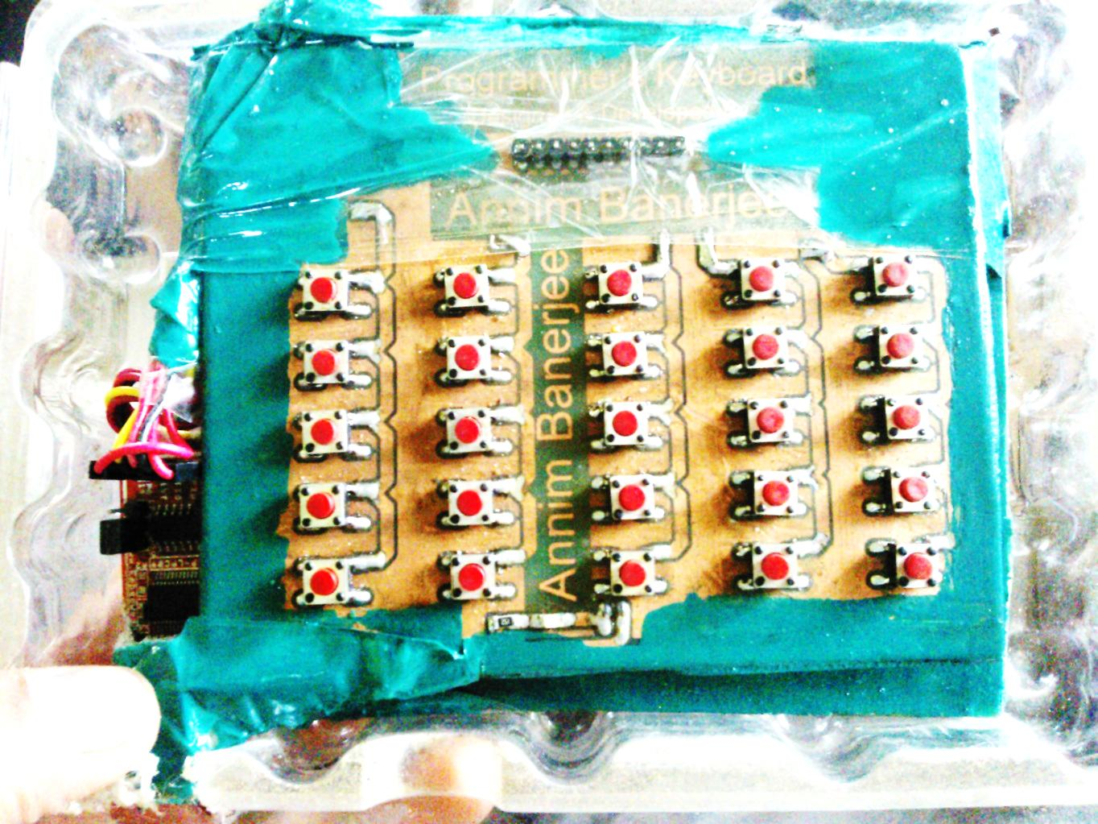
Results

Slide 23
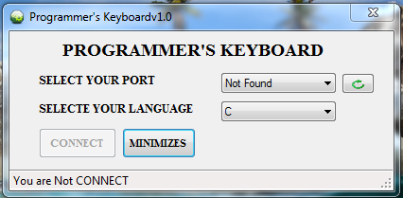
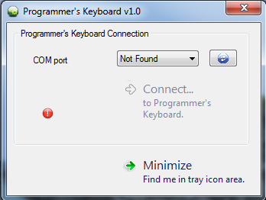
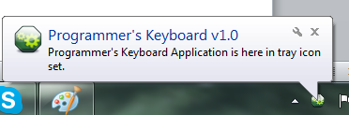
Results

Slide 24
Scope

Slide 25
Scope
The USB module should be included in the circuitry of controller board with best suitable USB-to-Serial converter chip.
Can be converted into a normal workable keyboard with 102, 104 keys.
Can be converted into a controller for specific game.
A good logic should be developed to replace the controller, i.e. MCU from the project and also UART communication can be re-designed by using very simple TTL logics. A small mechanism is been shown which might replace the MCU and also the USB-to-Serial converter chip, but this will be an experimental.

Slide 26
Bibliography
Books:
The 8051 Microcontroller And Embedded Systems Using Assembly And C, 2/E
ISBN: 8131710262, 9788131710265
Links:
http://pcbheaven.com/wikipages/How_Key_Matrices_Works/
http://www.learningaboutelectronics.com/Articles/How-does-a-matrix-keyboard-scanning-algorithm-work
http://www.engineersgarage.com/tutorials/how-to-make-a-pcb-at-home
http://www.ingeniumblog.net/2010/06/20-best-pcb-making-techniques/
http://www.embeddedmarket.com
http://www.onlinetps.com
http://vishaworld.com
http://www.flashmagictool.com/
http://www.esacademy.com/blog/category/flashmagic/
http://www.google.co.in/url?sa=t&rct=j&q=ft232rl&source=web&cd=1&cad=rja&sqi=2&ved=0CC4QFjAA&url=http%3A%2F%2Fwww.ftdichip.com%2FProducts%2FICs%2FFT232R.htm&ei=agZCUd7XC5CsrAfmj4GIDg&usg=AFQjCNGpVGg1DjvkQO3rhqGOpB-n6jA83A&bvm=bv.43287494,d.bmk
http://www.google.co.in/url?sa=t&rct=j&q=ft232rl&source=web&cd=2&cad=rja&sqi=2&ved=0CDMQFjAB&url=http%3A%2F%2Fwww.ftdichip.com%2FDocuments%2FDataSheets%2FICs%2FDS_FT232R.pdf&ei=agZCUd7XC5CsrAfmj4GIDg&usg=AFQjCNGami1T1YXLF1U9kCK2hDTudVhVnQ&bvm=bv.43287494,d.bmk

